Slide 1
ECE1658 Final Presentation
By: Kevin Hu

Slide 2
Initial VHC Design
Created linear system of equations to solve for polynomial coefficients
Created Matlab functions for phi and sigma and their derivatives
Calculated the potential functions numerically and fit to splines
Performed VHC checks
Created robot controller using symbolic equations for h, dhq, d(dhq)/dt

Slide 3
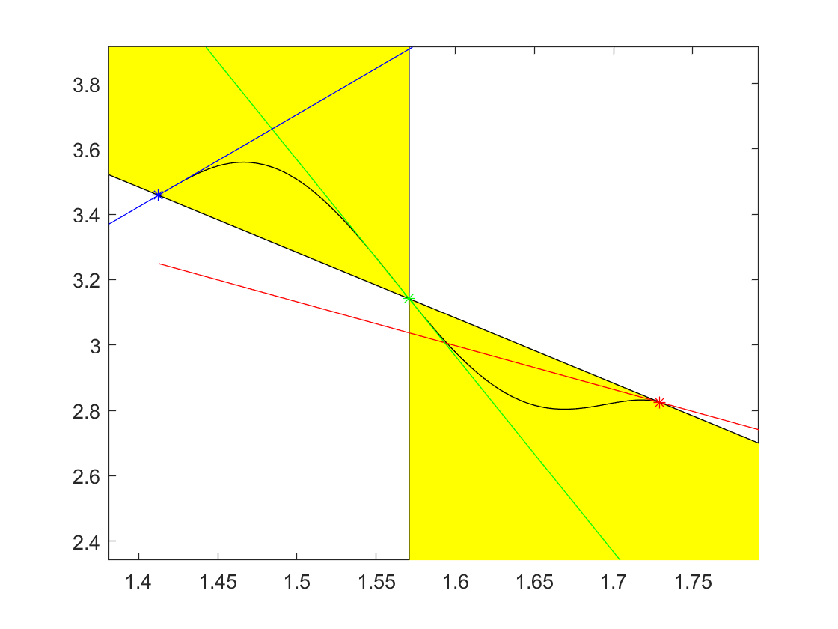
Plot of VHC Curve

Slide 4
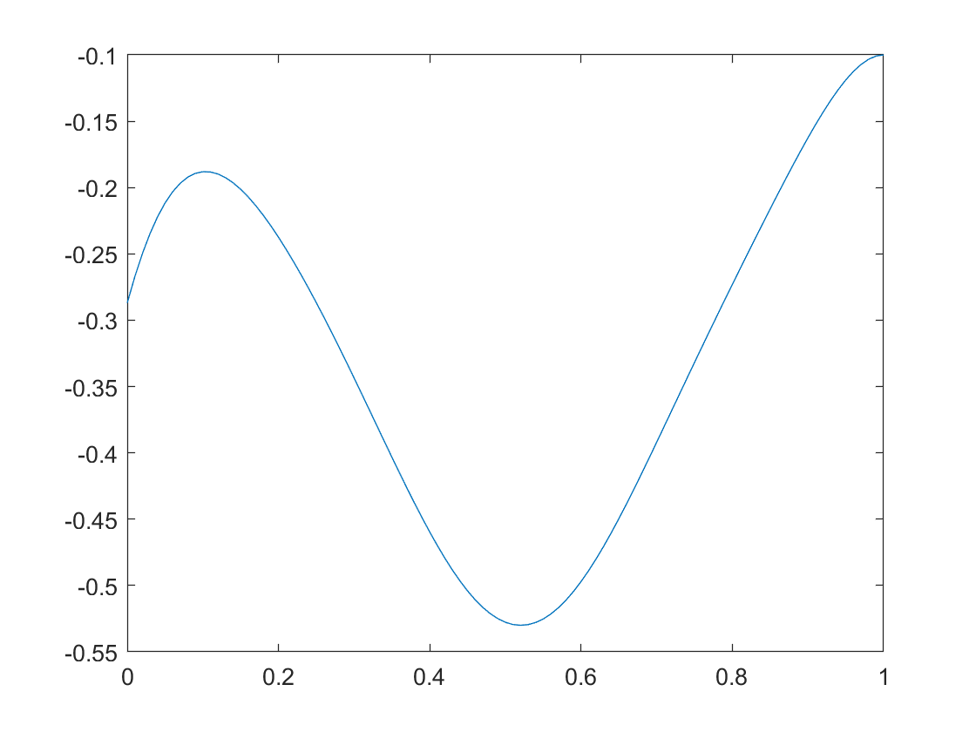
Plot of Transversality Condition

Slide 5
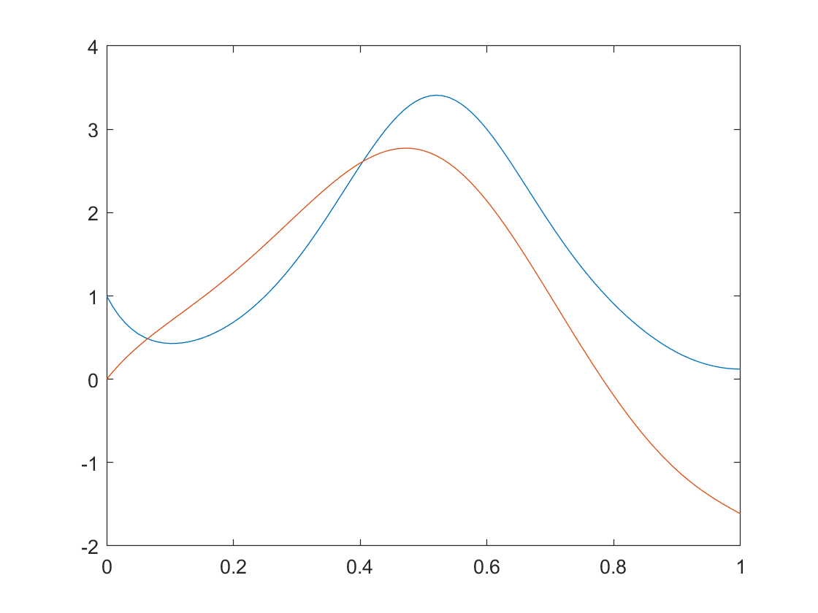
Plot of Potential Functions

Slide 6
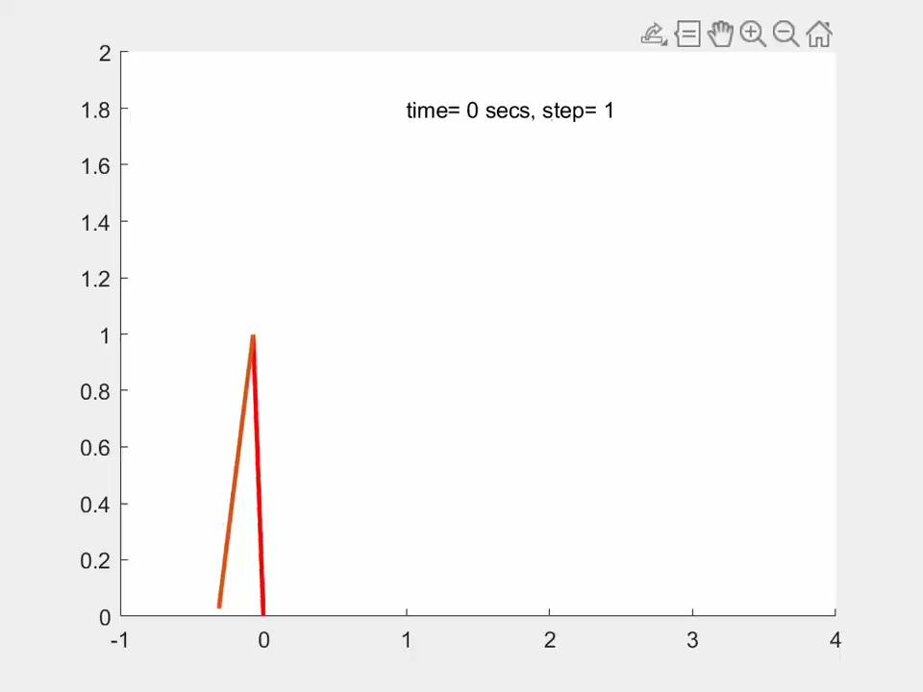
Video

Slide 7
Optimization Methodology
Created matlab functions for phi and sigma and their derivatives that depended on optimized parameters
Constraints separated into linear equality, linear inequality and nonlinear constraints
Potential functions calculated numerically and fit to splines

Slide 8
Optimization Details
Only successful in certain cases
Issues with fmincon not satisfying all the constraints and getting stuck in local minima
Sometimes constraints would be satisfied but fail VHC checks

Slide 9
Optimization Results
Evaluation function that gave best result was the evaluation function that made the curve as flat as possible at the endpoint, minimizing v1^2
Higher number of coefficients tested but 6 gave the best result
SQP algorithm used, seemed to perform better than default algorithm interior-point for fmincon
Passed VHC checks

Slide 10
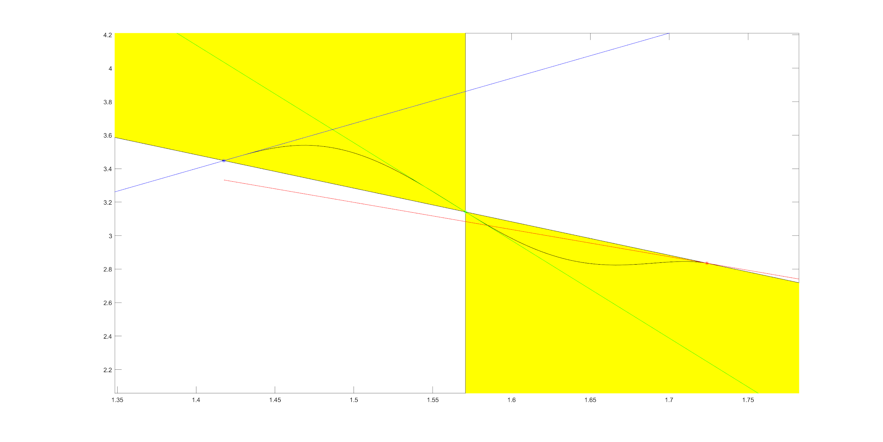
Plot of VHC Curve

Slide 11

Plot of Transversality Condition

Slide 12
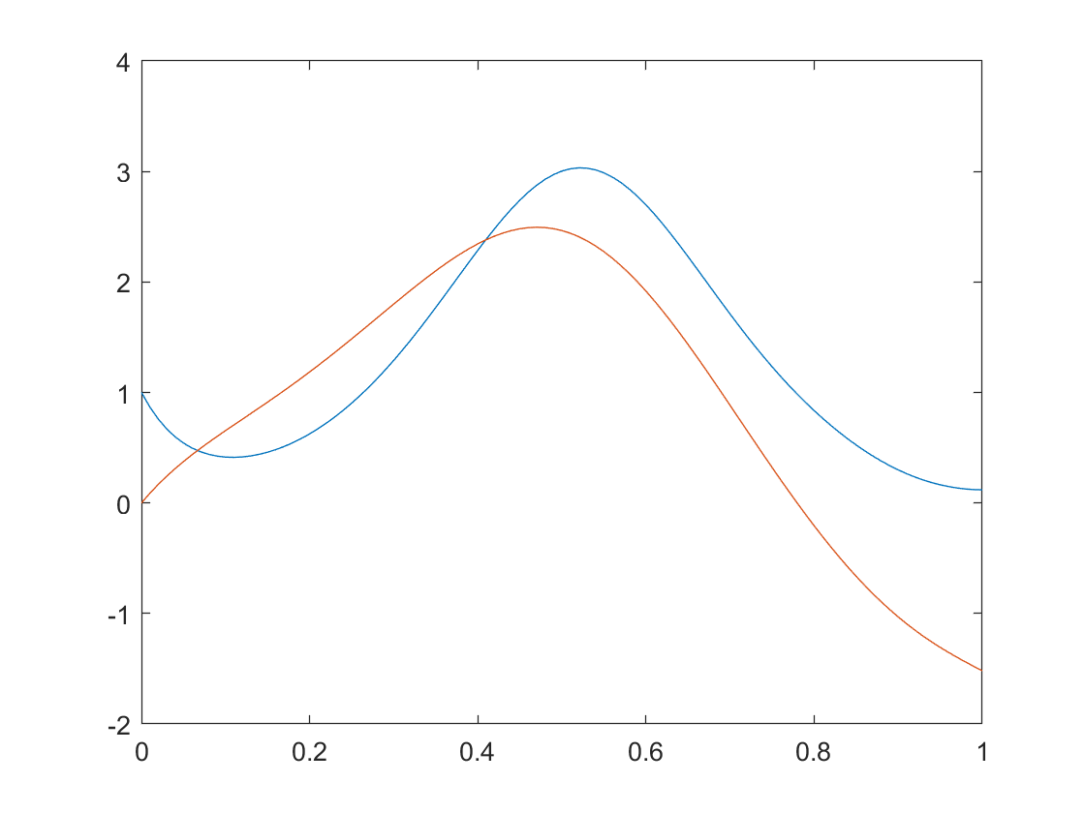
Plot of Potential Functions

Slide 13

Video

Slide 14
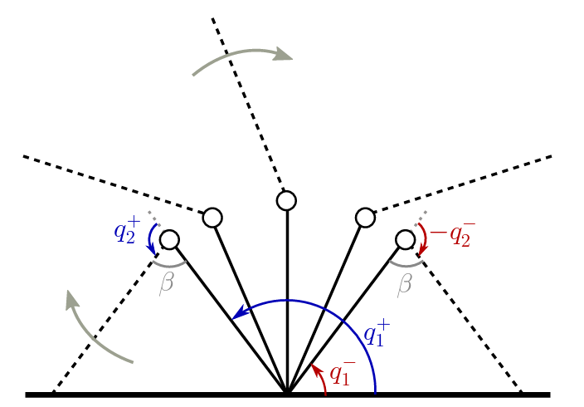
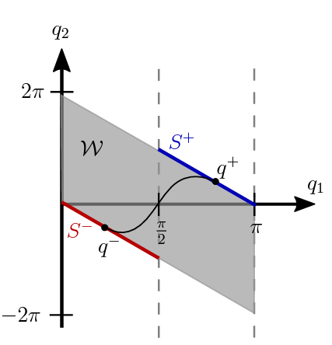
Walkover Gait VHC Curve
[1]
[1]

Slide 15
Problem Formulation
VHC curve for walkover gait was attempted to be found
Use similar optimization problem formulation as Part 1 but with some changes
Inspiration taken from the paper “On the Synthesis of Stable Walkover Gaits for the Acrobot” [1]

Slide 16

Methodology
Robot model, relabelling, and impact maps taken from the paper [1]
Main difference between method done previously is that a single - input planar control system is used to model both the hybrid invariance and transversality conditions
Sigma uses same parameterization as before, virtual control input u modelled by a 3 coefficient polynomial
Notes:
U is in the set of twice differentiable functions continuous in the domain theta_a to theta_b

Slide 17

Methodology
The unit tangent vector is also being solved for the optimization problem
There is a function that can transform t(Өb) into t(Өa)
Use these two equations to add the following equality constraints

Slide 18

Methodology
In order for tangent vectors to satisfy the transversality condition, the tangent vectors are required to satisfy the inequalities
There are conditions requiring the tangent vectors to point inside and outside the safe set

Slide 19
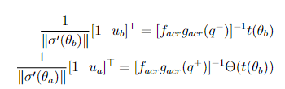
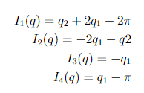
Methodology
Virtual control input has to follow u(Өa) = ua and u(Өb) = ub using the equation
Finally we have the inequalities representing the safe set
Same conditions for VHC having stable hybrid limit cycle as part 1

Slide 20
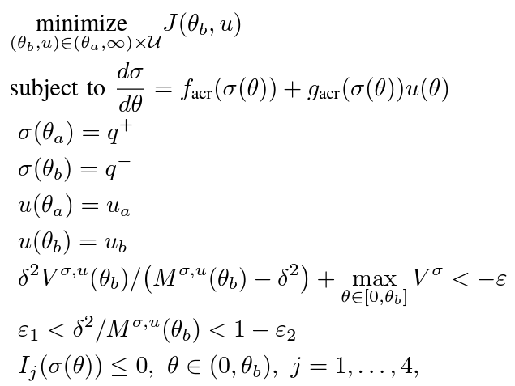
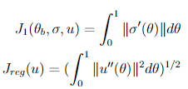
Overview of Optimization Problem

Slide 21
Results
Unfortunately without a good initial condition, fmincon will not converge to a solution and there are several constraint violations
Initial conditions are generated randomly within a reasonable range to hopefully result in a minimum and constraints to be satisfied
Best solution has 2.358 feasibility score so probably not a VHC curve

Slide 22
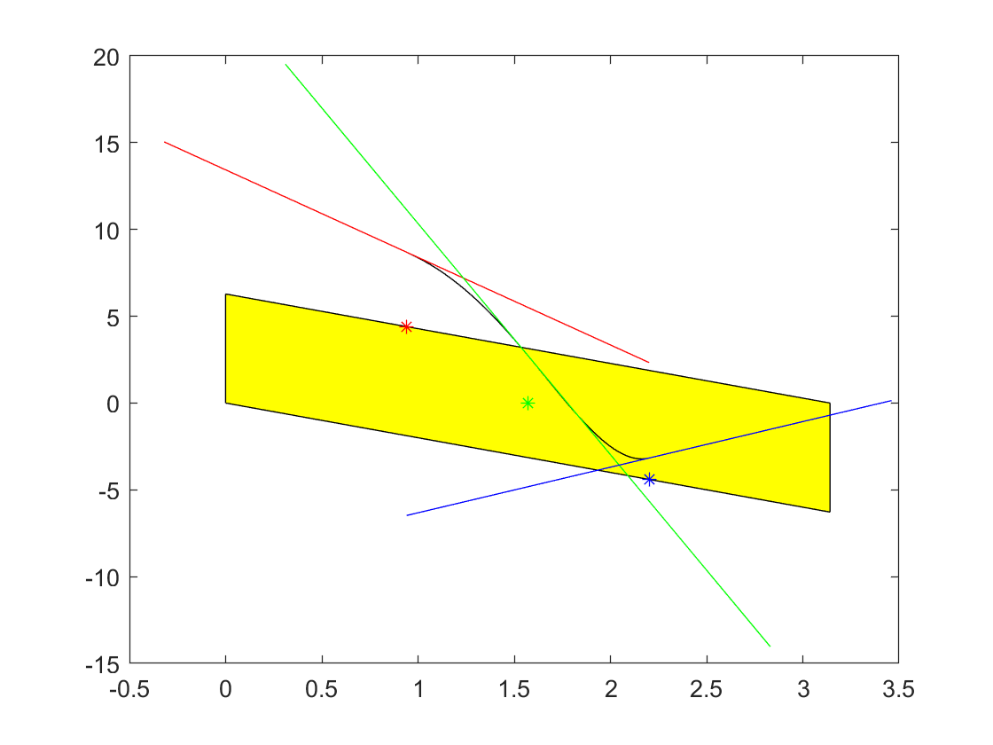
Plot of Generated Curve

Slide 23
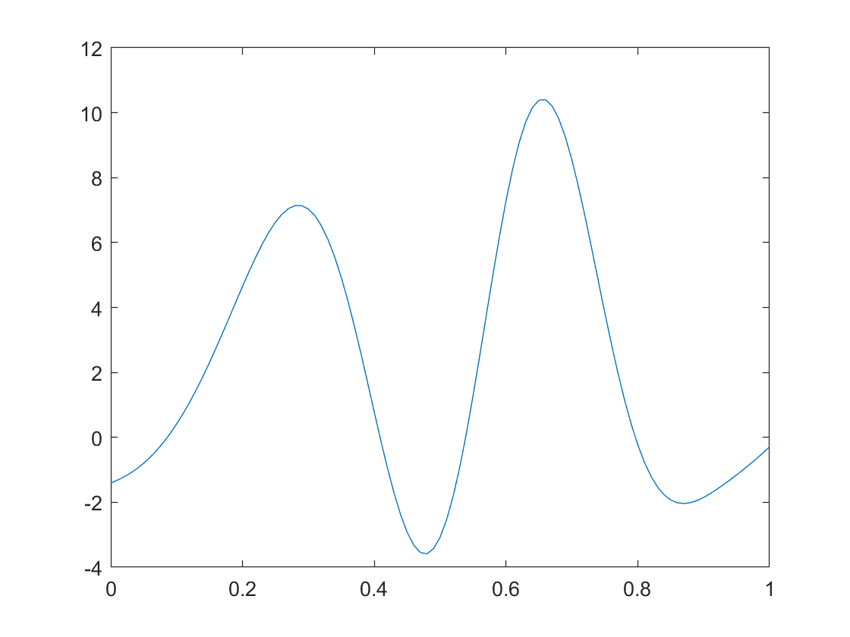
Plot of Transversality Conditions

Slide 24
Questions?

Slide 25
References
[1] E. Kao-Vukovich and M. Maggiore, “On the synthesis of stable walkover gaits for the acrobot,” IEEE Transactions on Control Systems Technology, vol. 31, no. 3, pp. 1379–1394, May 2023. doi:10.1109/tcst.2022.3224315

